Slide 1
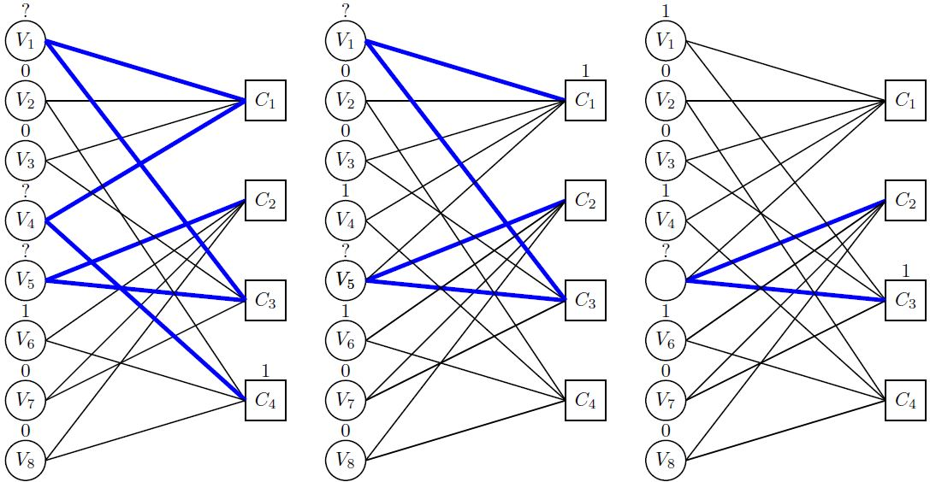

$$V_{5}$$

